Slide 1

ENGINEERING CHEMISTRY
Asha A
Department of Science and Humanities

Slide 2

ENGINEERING CHEMISTRY
Module 6- Corrosion Chemistry
Class content:
Corrosion control
Cathodic protection
Sacrificial anode method
Impressed cathodic current method

Slide 3
ENGINEERING CHEMISTRY
Module 6- Corrosion Chemistry
Cathodic protection:
By converting it completely into cathode and no part of it is allowed to act as anode
Cathode does not undergo corrosion so the structure is protected
Cathodic protection
Sacrificial anode method
Impressed current method

Slide 4
ENGINEERING CHEMISTRY
Module 6- Corrosion Chemistry
Sacrificial anode method:
In this method, protected metal structure is converted into a
cathode by connecting it to a more active metal
This active metal (example: zinc, magnesium) acts as
an auxiliary anode
These metals being more active, acts as anode and undergo
preferential corrosion, protecting the metal structure
Since the anodic metals are sacrificed to protect the metal
structure, the method is known as sacrificial anode method
Exhausted anodes have to be replaced periodically

Slide 5
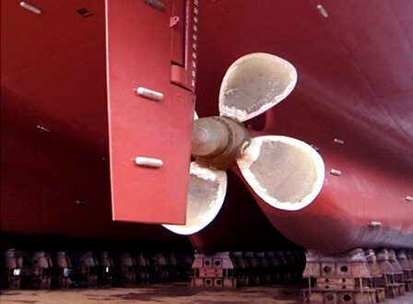
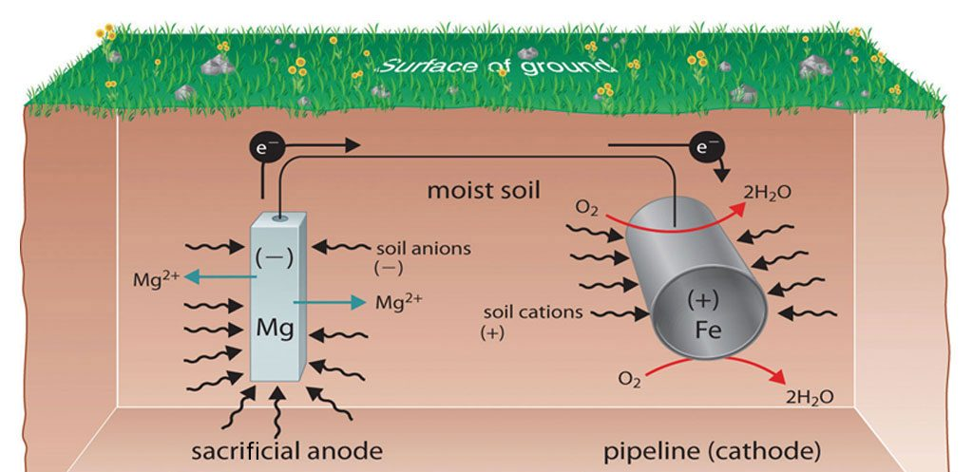
ENGINEERING CHEMISTRY
Module 6- Corrosion Chemistry
Examples:
Mg/Zn bars are fixed to the sides of ocean going ships to act as sacrificial anodes
Mg/Zn blocks are connected to buried pipe lines
A Mg block connected to a buried oil storage tank
Source:https://thenavalarch.com/ship-corrosion-cathodic-protection-sacrificial-anodes/
Source:https://www.pipelineprotection.co.uk/services/cathodic-protection/

Slide 6
ENGINEERING CHEMISTRY
Module 6- Corrosion Chemistry
Advantages:
The method is simple
Low installation cost
Does not require power supply
Disadvantages:
Involves recurring expenditure for replacement of consumed
anodes

Slide 7
ENGINEERING CHEMISTRY
Module 6- Corrosion Chemistry
Impressed current method:
By applying a direct current
The protected metal is made cathodic by connecting it to the cathode
of the external source of current
Anode of the external source is usually connected to an inert electrode
like graphite; Platinum, silicon, iron are also used as anodes
A backfill of coke ,bentonite is used to improve efficiency of the anode
The metal structure being cathode does not undergo corrosion
Anode being inert remains unaffected

Slide 8
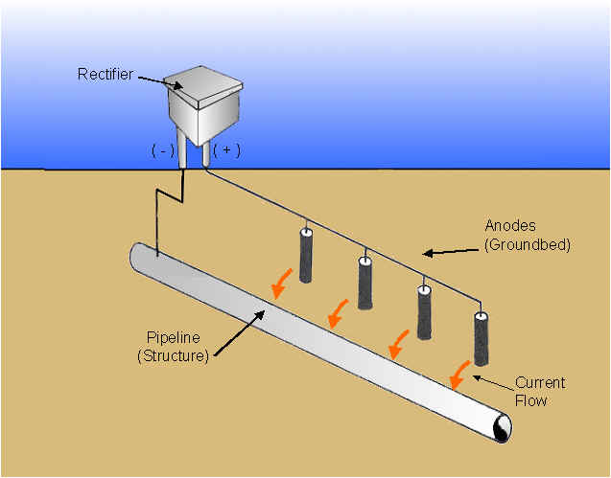
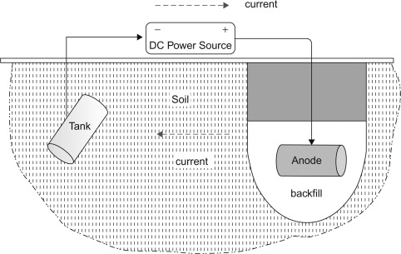
ENGINEERING CHEMISTRY
Module 6- Corrosion Chemistry
Source:https://www.mcwaneductile.com/blog/v-bio-r-or-cathodic-protection-an-honest-comparison/
Source:https://www.sciencedirect.com/topics/engineering/impressed-current-system

Slide 9
ENGINEERING CHEMISTRY
Module 6- Corrosion Chemistry
Advantages:
One installation can protect large area of metal
Limitations:
Rather expensive, since it needs high current for safe protection of structure
If the impressed current is not uniform on the entire surface of the protected structure, localized corrosion takes place on the protected metal

Slide 10
ENGINEERING CHEMISTRY
Module 6- Corrosion Chemistry
If hydrogen liberation is the cathodic reaction on the metal surface, then the protected metal may suffer from hydrogen embrittlement
Hydrogen embrittlement:
H₂ molecule being small enters the metal lattice and when the pressure increases , it causes blisters and makes the metal brittle

Slide 11
ENGINEERING CHEMISTRY
Module 6- Corrosion Chemistry
Class content:
Corrosion control
Anodic Protection
Impressed current method

Slide 12
ENGINEERING CHEMISTRY
Module 6- Corrosion Chemistry
Anodic protection:
Prevention of corrosion by impressed anodic current is called as anodic protection
The article to be protected is made anode by connecting it to the anode terminal of the power source
Can be used only for metals which show active-passive behaviour like nickel, iron, chromium, titanium and their alloys
On applying an optimum potential these metals get passivated and rate of corrosion decreases

Slide 13
ENGINEERING CHEMISTRY
Module 6- Corrosion Chemistry
Active – passive transition of metals with the application of a potential can be explained from the potential-current curve
Transpassive region
Passive region
E
E_{p}
i_{passive}
i_{crit}
log i

Slide 14
ENGINEERING CHEMISTRY
Module 6- Corrosion Chemistry
A known potential is applied to the metal specimen and current is measured
As the potential is increased, initially the current also increases, and it indicates the dissolution of metal
This trend continues until the current reaches a critical value (i_{crit}) and passivation due to the development of oxide layer sets in
The potential required for the passivation due to the development of oxide layer, this potential called passivating potential (E_{p})
Transpassive region
Passive region
E
E_{p}
i_{passive}
i_{crit}
log i

Slide 15
ENGINEERING CHEMISTRY
Module 6- Corrosion Chemistry
Above Ep, the current flow decreases and reaches a minimum value called passivation current, i_{passive}
If the potential is increased further, the metal remains unattacked up to a particular potential is reached. In this range, corrosion rate of the metal is very small. This potential range, in which anodic potential can be achieved, is called passive region
If the potential is increased further, corrosion rate increases and this region is called the transpassive region
The optimum potential for protection is determined by electrochemical measurements
Transpassive region
Passive region
E
E_{p}
i_{passive}
i_{crit}
log i

Slide 16
ENGINEERING CHEMISTRY
Module 6- Corrosion Chemistry
Anodic protection to a structure is applied by using a device
called potentiostat
It is an electronic device that maintains a metal at a constant potential with respect to a reference electrode
Potentiostat has three terminals, one connected to the anode, another to an auxillary cathode(Pt) and the third connected to a reference electrode

Slide 17
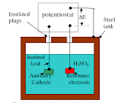
ENGINEERING CHEMISTRY
Module 6- Corrosion Chemistry
Anodic protection of a steel tank carrying H₂SO₄
One terminal is connected to the storage tank(anode)
Other is connected to the reference electrode and a constant potential corresponding to the passive range is maintained between tank and the reference electrode
The third terminal is connected to an auxiliary electrode like Pt
Source:https://uomustansiriyah.edu.iq/media/lectures/5/5_2016_04_20!11_15_38_AM.pdf

Slide 18
ENGINEERING CHEMISTRY
Module 6- Corrosion Chemistry
Advantages:
Applicability in extremely corrosive environments
Low current demand
Disadvantages:
Restricted to metals that show active-passive behaviour
Initial installation cost is high
Cannot reduce corrosion rate to zero unlike cathodic protection

Slide 19
THANK YOU
Asha A
Department of Science and Humanities

